Slide 1
SMART Health Cards Framework
SMART Health Cards allow you to keep a copy of your important health records on hand and share it with others if you choose. You can get a copy of your SMART Health Card through a qualified issuer, including pharmacies, hospitals, healthcare providers, medical labs, public health agencies, and more.
@JoshCMandel, MD
Chief Architect for SMART Health IT & Microsoft Health Futures bit.ly/smart-fhir-tech

Slide 2
Today each {}::{} relationship is a blank slate {} == patient, provider, payer, pharma, retail, ...
Identity
"Who are you?" or "What qualifications do you have"
How do you present this information?
Authentication
"How do you sign in?"
What protections should be placed on your account
Sharing, Privacy, Transparency
When can I share your data? With whom?
What data should flow?
How would you like to be notified?
How should I protect your privacy?
bit.ly/smart-fhir-tech

Slide 3
Today, things are a mess.
"Who are you?"
In-person identity proofing
E.g., "Come in to the office to receive a sign-up code"
Builds on existing healthcare relationships
Slow, expensive inconvenient
Different every time
Knowledge-base identity proofing
E.g., "What color is your Volkswagen?"
Fast and automatic, when it works
Expensive for relying parties
"Proof" data are guessable, subject to breach
Incentivizes data hoarding
bit.ly/fhir20-did

Slide 4
Today, things are a mess.
"How do you sign in securely?"
Pairwise accounts and passwords
Diverse, conflicting requirements
Confusing → password resets or management tools
2-factor auth or 2-step verification
Varied workflows (different apps, SMS, email, ...)
Single Sign-On
E.g., "Sign in with Facebook"
E.g., "Sign in with Google"
Centralized control over accounts
Every sign-in means being tracked

Slide 5
Today, things are a mess.
Sharing, Privacy, Transparency
On-by-default, HIPAA-enabled sharing
Opaque to consumers
Surprising, even when legal
Accounting of disclosures
In theory! Good luck, in real life...
Data "de-identified" and sold / shared
Sharing fails when we need it most
2020 "TEFCA" is re-hashing "NHIN Exchange" protocols from 2010
Probabilistic matching leaves sharing up to chance
Manual link validation requires extensive buy-in
bit.ly/smart-fhir-tech

Slide 6
Self-owned identity standards are emerging.
Decentralized Identifiers, aka "DID"s
https://w3c.github.io/did-core/
Authentication (OpenID Foundation, DIF)
Builds on OpenID Connect single sign-on workflow
Secure cryptographic keys on consumer device
Protected by biometrics or PIN
No built-in "tracking" by identity providers

Slide 7
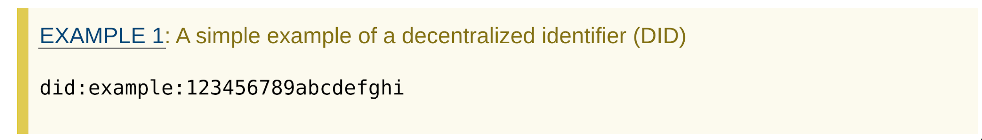
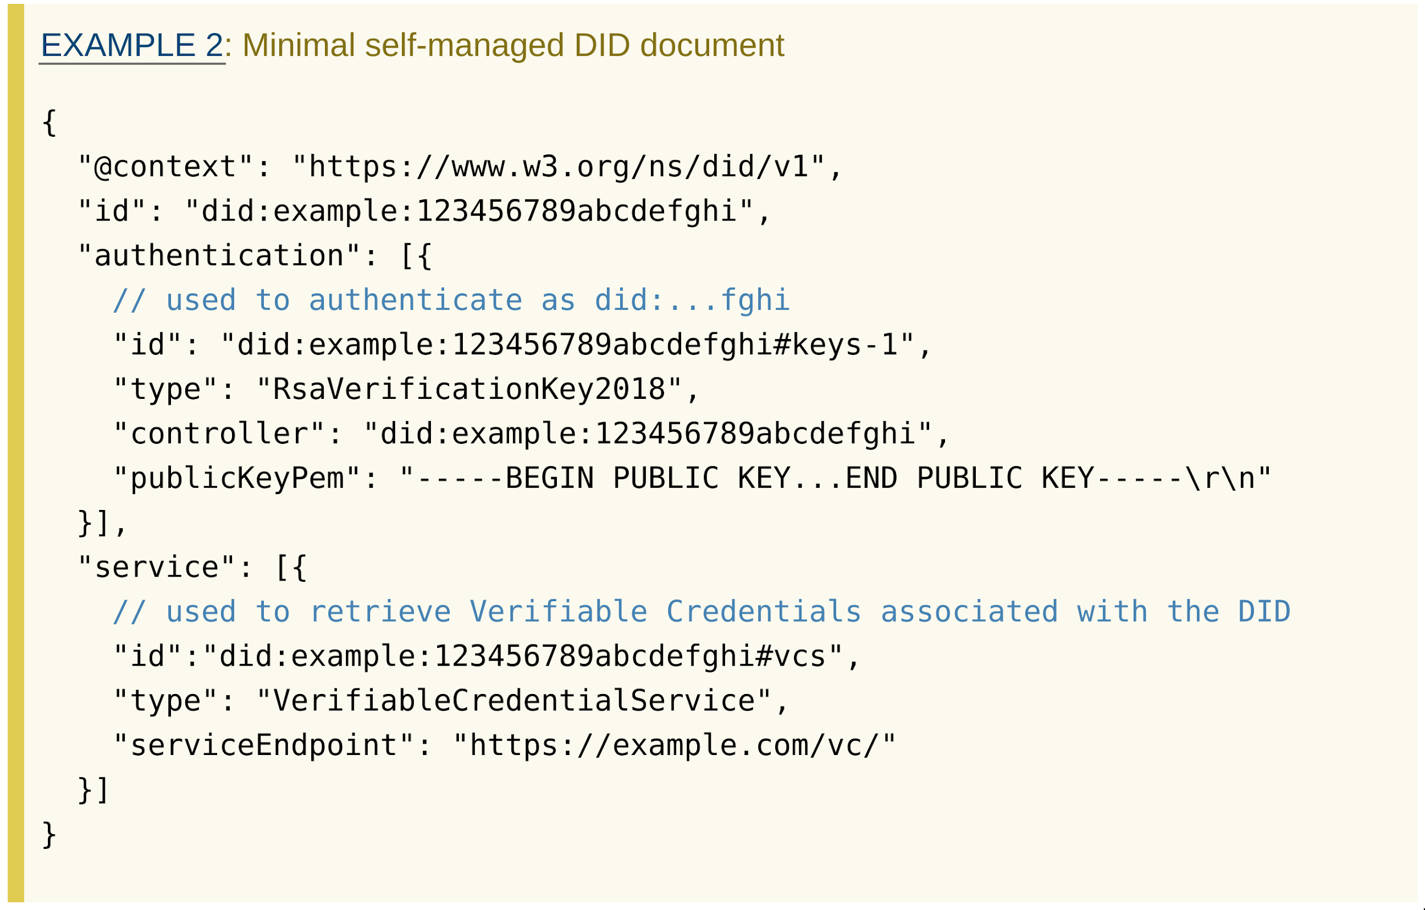
Self-owned identity standards are emerging.
Decentralized Identifiers, aka "DID"s

Slide 8
Standards are emerging for individual control
Verifiable Credentials, aka "VC"s
https://w3c.github.io/vc-data-model/
Identity Standards for "verifiable credentials" (W3C, DIF)
Credentials work like the business cards in your wallet
Anyone can issue or present a credential by following standards
Credentials can be mixed/matched/shared at will
=> ID Proofing costs are amortized, not duplicated

Slide 9
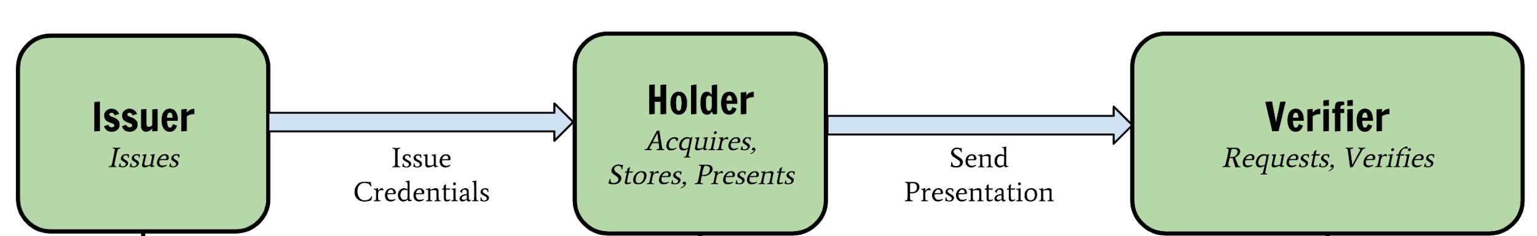
Self-owned identity standards are emerging.
Verifiable Credentials, aka "VC"s

Slide 10

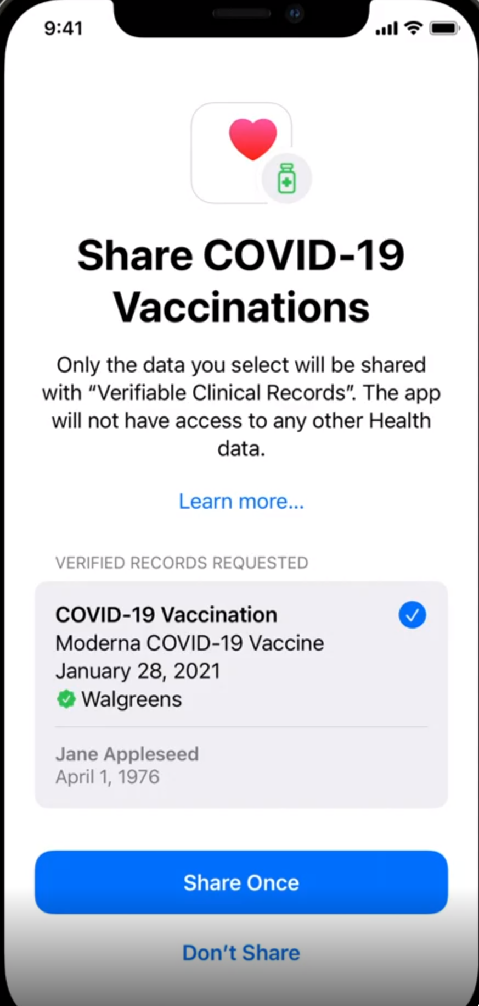
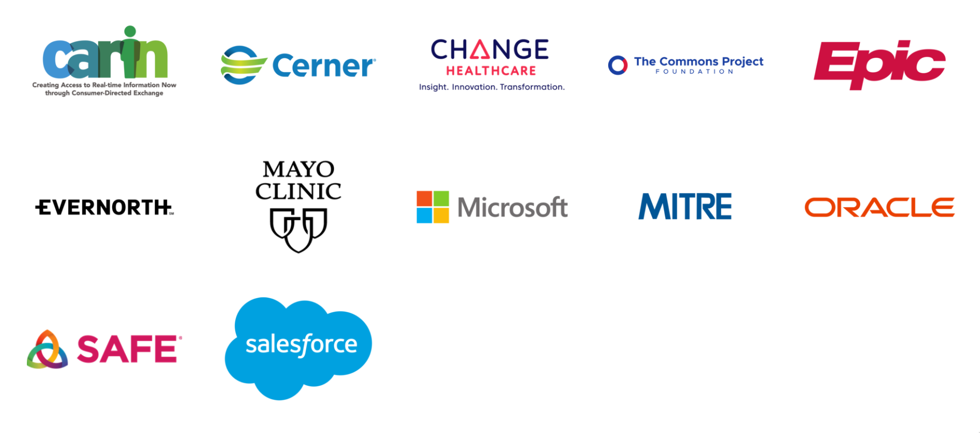
Community supporting SMART Health Cards (Including vci.org, see tomorrow's keynote!)
(Live in Quebec today; more soon.)

Slide 11
SMART Health Cards for COVID-19 and beyond
Put consumers in charge of holding and presenting lab results
Support the "rich semantics" (read: complexity) of real-world care
Science is evolving fast!
Interpretations are a moving target
Boil down a result to its essence for specific use cases
E.g., return to the workplace
E.g., back to school
E.g., travel
Everything based on open standards; components are substitutable
Many issuers
Many wallet apps
Many relying parties
No pre-coordination

Slide 12
Case Study: What happens without Health Cards?
I get tested
I get results in a portal or a mobile app
I find some way to share results
Download → print/fax/email (example from Josh's May 2020 serology test)
Success: well established tech, loose coupling
Failure: painful, multi-step sequence, no "rails" to guide me
Failure: result aren't verifiable
Grant access directly to an RP application
Success: guide process
Success: results travel to the RP directly (i.e., verified)
Failure: dramatic over-sharing of sensitive data
Failure: requires pre-coordination between RP + FHIR Server

Slide 13
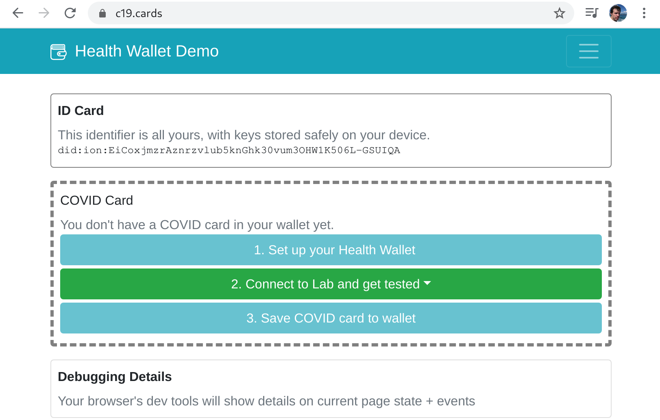
VC Case Study: How can we improve?
demo at c19.cards

Slide 14
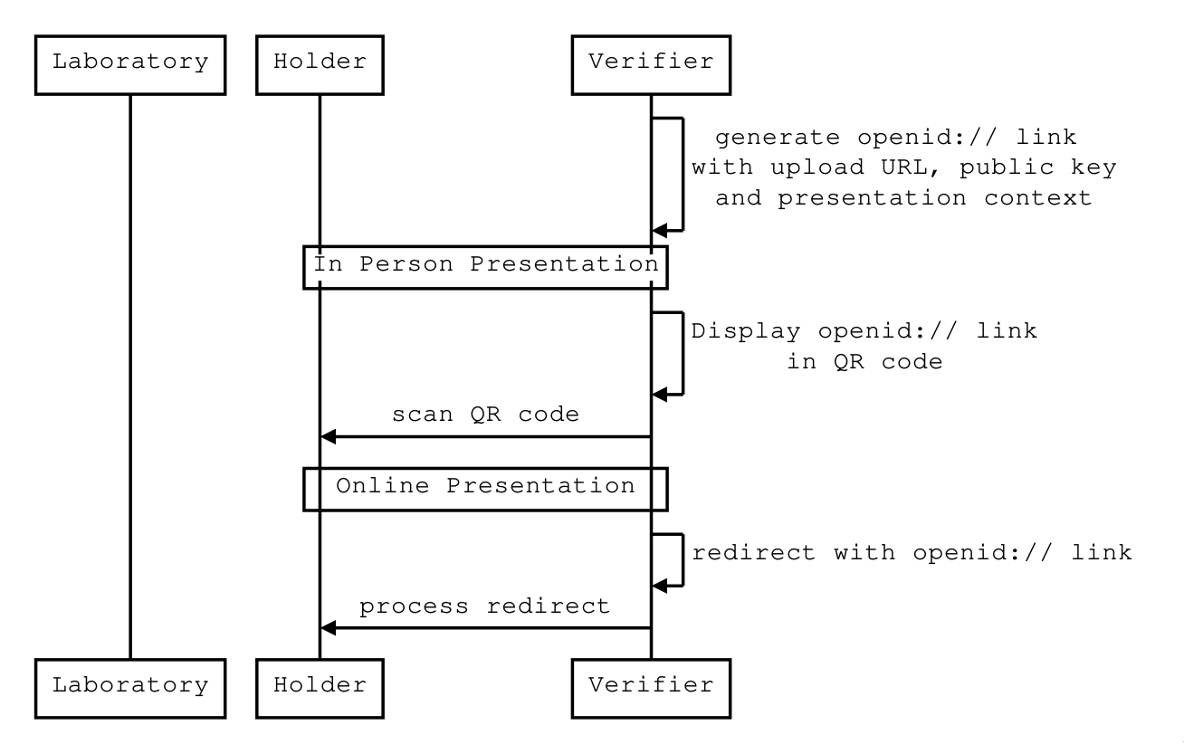
VC Case Study: OpenID "DID SIOP", Request

Slide 15
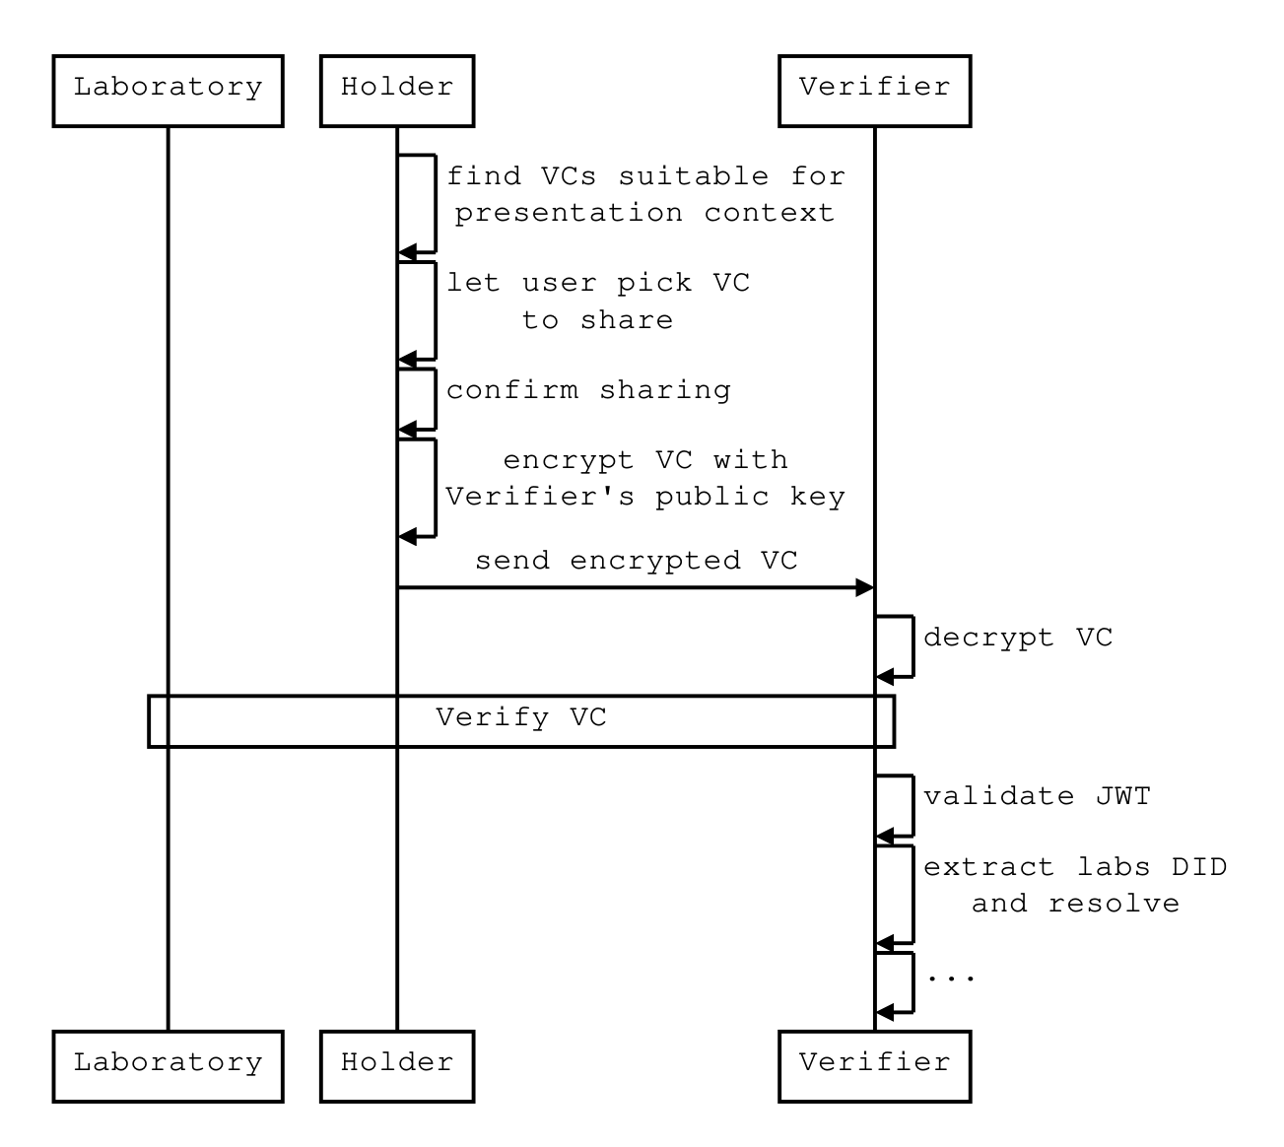
VC Case Study: OpenID "DID SIOP", Response

Slide 16
Case Study: Designing a C19 Health Card
Combine the strengths of
W3C JSON (credential semantics: who issued it, when does it expire...)
FHIR JSON (clinical semantics: what tests were performed, what specimens, what results...)
Example JSON structure here
Note the top-level "type" to communicate that this is a "COVID-19 card"
Note the ".credentialSubject.fhirBundle" attachment point for FHIR data
Note the use of FHIR for
Demographic / identity data (* privacy implications!)
Lab reporting data
VC ties back to a user's identity via
FHIR Patient resource (conventional demographics for matching)
Designed for use alongside "traditional" identity systems
E.g., driver's license, traveler account, student account

Slide 17
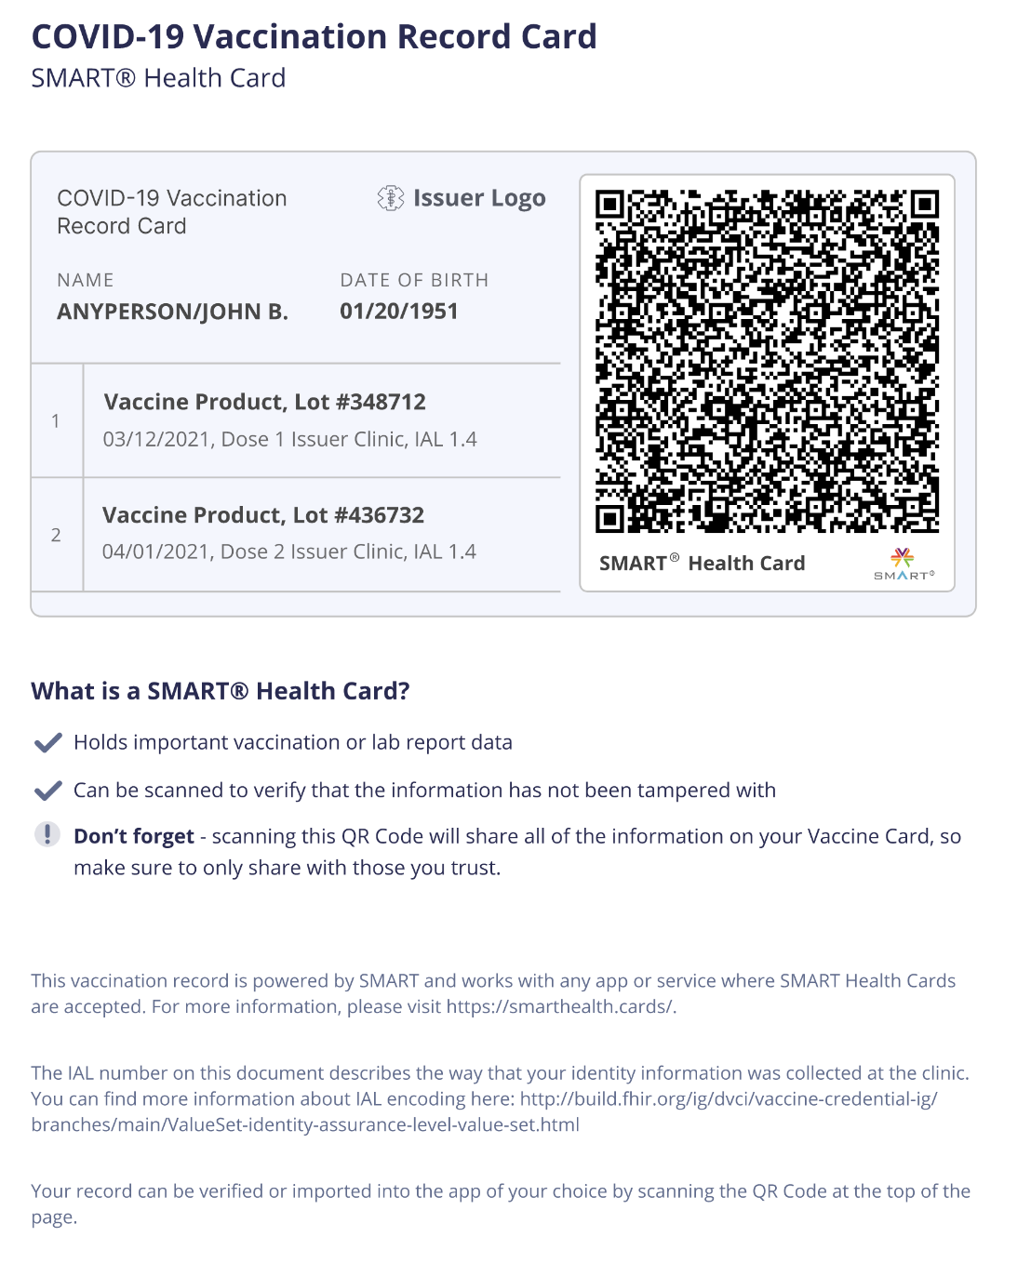
Issuance Flows
Hands you a sheet of paper
Offers PDF download
Offers .smart-health-card JSON file
FHIR Operation
Patient/:id/$health-cards-issue

Slide 18
Presentation Flows
Display QR on paper or phone
Upload, email (or, sigh!, fax) a QR
Send .smart-health-card JSON file
E.g., for larger data sets
Mobile app "intent" or "share request"
On-device sharing
Will vary by OS

Slide 19
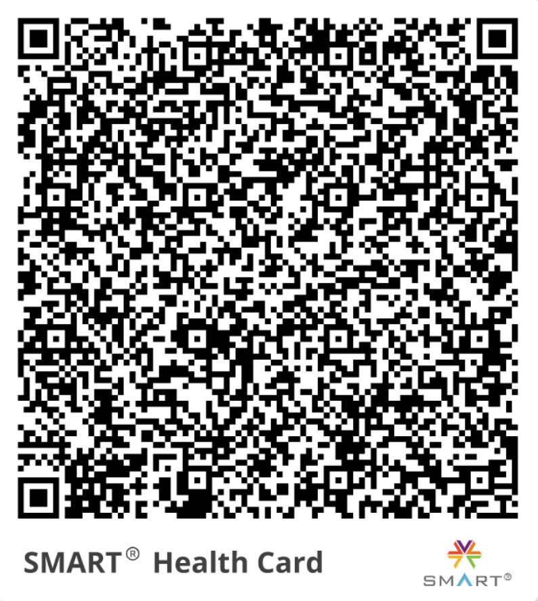
QR Encoding
V22 symbol at most (ease of scanning)
Chunking if data payload is beyond xalaxiu
Prefixes (shc URI scheme, chunk n of m)
Numeric mode (2 digits~100 values, in 10 bits~1024 values)

Slide 20
Key Resources
Specifications (IGs)
Framework spec.smarthealth.cards
Profiles (Vaccination and Testing) vci.org/ig/vaccination-and-testing
Demo Tools
Wallet c19.cards
Issuer and verifier portals demo-portals.smarthealth.cards
Validation Tools
Health Cards Validation SDK github.com/microsoft/health-cards-validation-SDK
HL7 FHIR Validator confluence.hl7.org/display/FHIR/Using+the+FHIR+Validator

Slide 21
Credential design bonus topic (time permitting)
Detailed data credentials vs actionable summaries

Slide 22
Self-owned identity standards are emerging.
Permissions, disclosures, and policies
Still early days, but emerging standards…
Consent Receipts → Dashboard of what's being shared
Personal Data Hubs → Manage data in place, by policy Shared secure storage backend for apps

Slide 23

Health Cards vs "Passes"
SMART Health Card e.g., Pfizer vaccine dose 2021-01-04, name=Josh Mandel, ...
SMART Health Card e.g., Pfizer vaccine dose 2021-01-04, name=Eve Everywoman, ...
User Survey e.g., any fever today?
Context (Algorithm, Identity, ...) e.g., jurisdiction, algorithm, expectedDemographics, destinationCountry, ...
Execute Specified Algorithm on Inputs
Ideally in some ~trustworthy compute environment
(e.g., trusted third party, cloud confidential compute node, or TPM)
"Summary" credential (a.k.a. "Pass")
[summary outputs] e.g., alg=cdc-flight-rules, ver=0.1.2, status=OK
[? ID binding] e.g., demographicMatch=0.85 [? ID passthrough] e.g., DOB=1980-10-10

Slide 24
Practical Challenges
Credential lending, and binding to real-world identity
With a driver's license; with a student account; with a travel account
Trade-offs between privacy and strength of identity binding, clinical detail
Forward-looking topic: selective disclosure at presentation time
Identity proofing (or lack thereof) at time of immunization
Which issuers are trustworthy? ("Trust Frameworks")
Multiple frameworks launching at national and regional level
Differences in goals/scope
SMART Health Cards aligns with standardized FHIR models
SMART Health Cards leaves "trust framework" out of scope

Slide 25
Questions? Discussion?
See also spec.smarthealth.cards/#faq

